Slide 2
Choreography and Orchestration

Slide 3

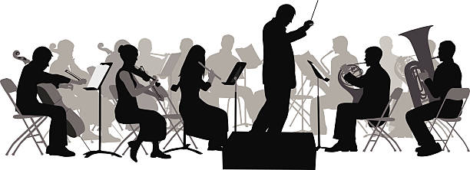
Choreography
Orchestration

Slide 4
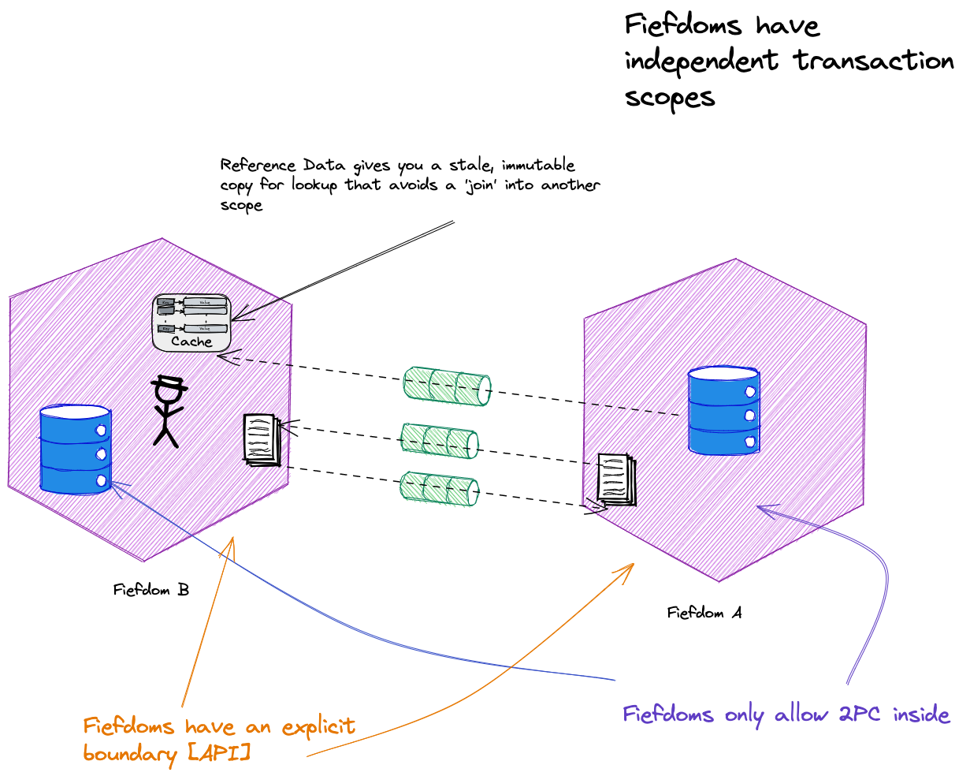
Pat Helland – Autonomous Computing
OUTSIDE DATA
INSIDE DATA
Notes:
Fiefdom – an autonomous component boundary; it has encapsulated data; has an explicit boundary [may be an API]; no distributed transactions across fiefdoms, only “INSIDE its belly”
[A microservice is one type of fiefdom, but turtles all the way down, and a phone client is also a fiefdom (it can be offline)]
Is a fiefdom a microservice - turn it around, a microservice is a fiefdom, but so is an app running on a phone, or in a browser.

Slide 5
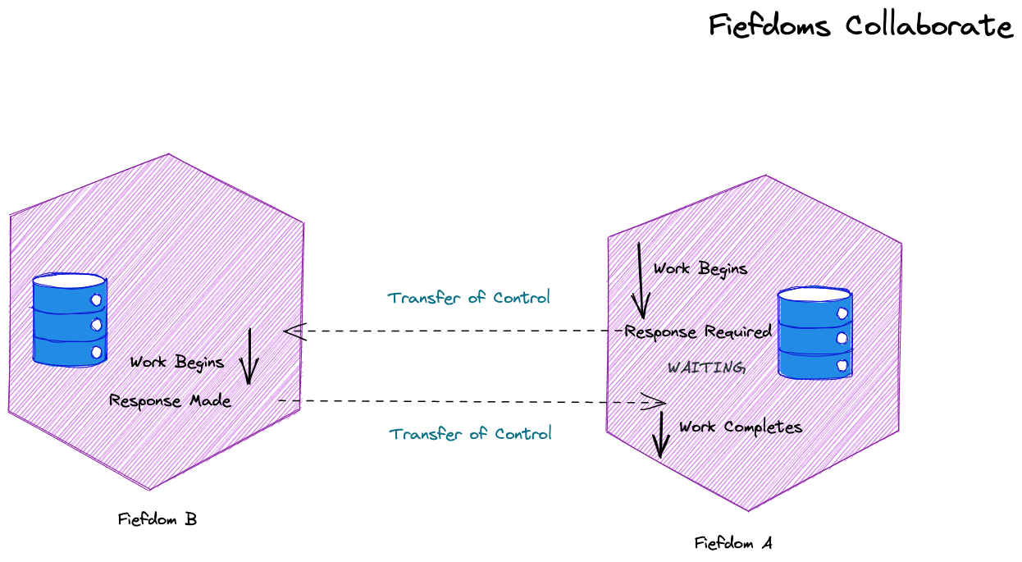
Fiefdoms have different responsibilities, but sometimes a fiefdom must request a service from another fiefdom. This can imply a fiefdom must transfer control.
Because we transfer control we think of this as a conversation or a dialog – a collaboration.

Slide 6
There is uncertainty here. We do not know how the other fiefdom will react. It might fail, cancel, or timeout. We need a way to manage that uncertainty.
“In a system that cannot count on distributed transactions, the management of uncertainty must be implemented in the business logic.” – Pat Helland

Slide 7
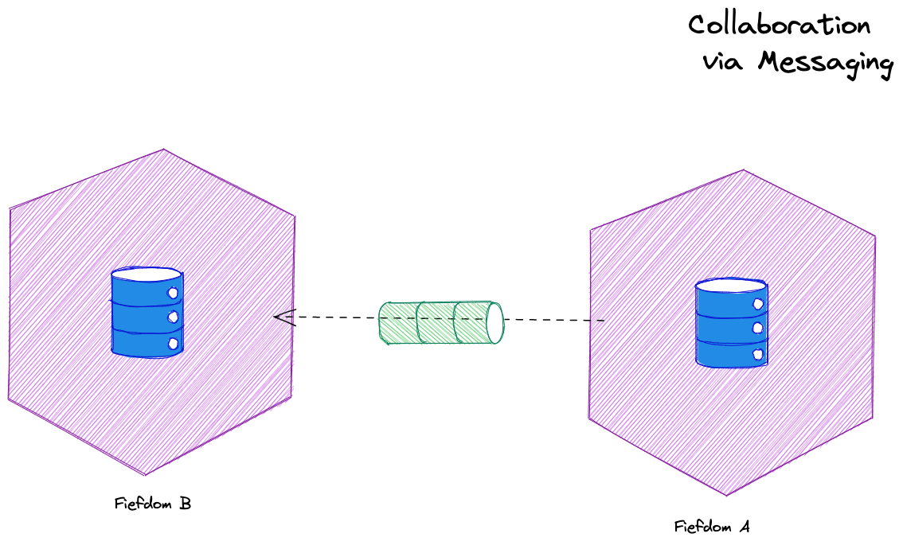
We do not use synchronous communication between fiefdoms – which implies holding open a transaction for a response – to update multiple entities. We use messaging.
Notes:
Because we cannot have a transaction spanning two entities we do not use synchronous communication – which implies holding open a transaction for a response – to update multiple entities
“If you can’t update the data across two entities in the same transaction, you need a mechanism to update the data in different transactions. The connection between the entities is via a message.”
Method calls are typically synchronous with respect to the calling thread. They are also synchronous with respect to the calling object’s transaction. While the called object may or may not be atomically coupled with the calling object, the typical method call does not
atomically record the intent to invoke a message and guarantee the at-least-once invocation of the called message. Some systems wrap message-sending into a method call and I consider those to be messages, not methods.

Slide 8
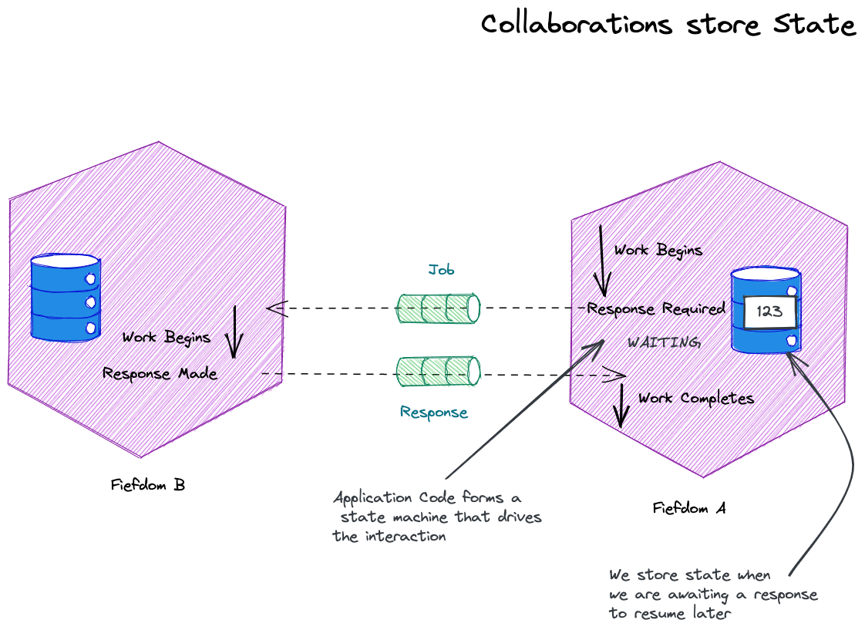
An activity is the code we execute (in response to a request, timer pop etc).
Activities are state machines to track an incoming collaboration and its sequence of messages.
Resilience provided by an activity may be a timeout forcing a step to be retried or abandoned, not simple recovery of state
An activity manages retries of operations
The activity may store state that allows us to resume an activity in the event of failure.

Slide 9
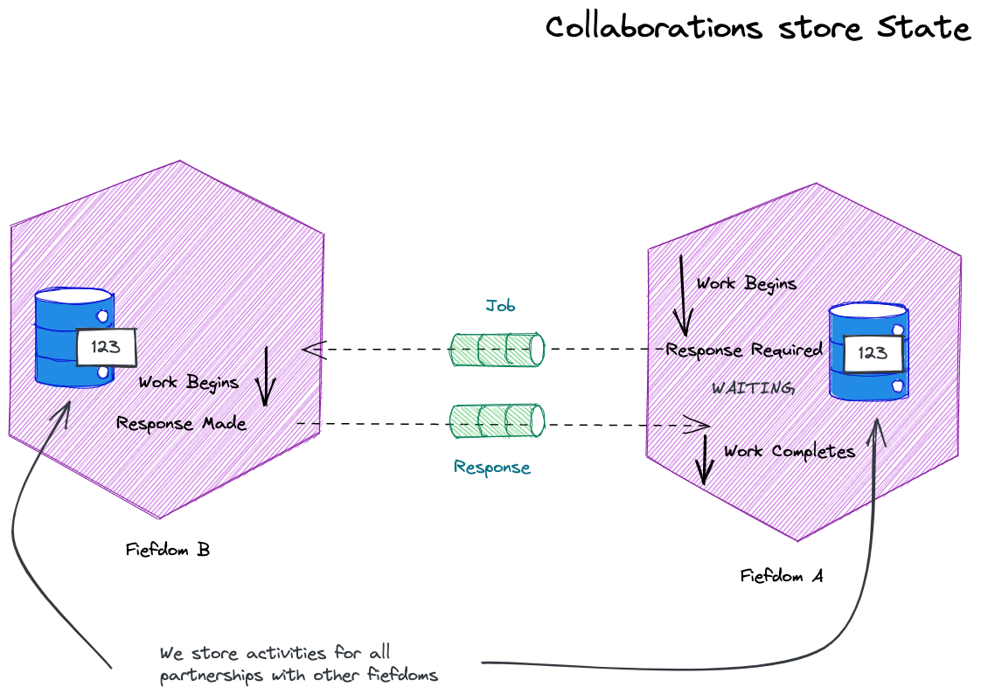
Each party has a record of the conversation – it keeps in the activity the record of the messages it sent and received.

Slide 10
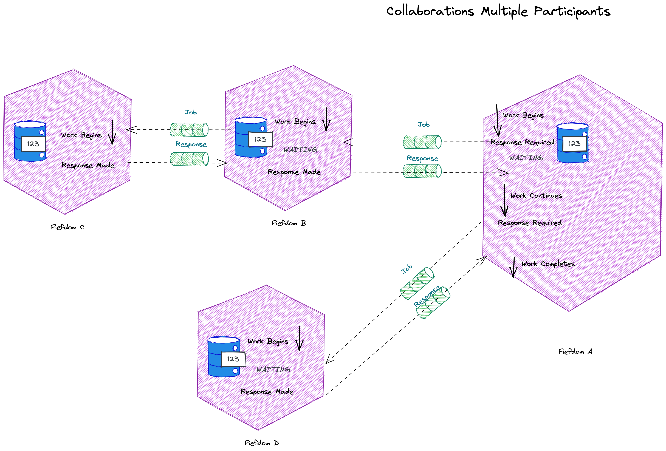
Some activities may create new collaborations to talk across other boundaries. Each activity is a long-running state machine supporting the flow of messages across one or more collaborations.

Slide 11
An activity needs to know which request a response was for; it does this via a correlation id: this is a response to that job.
The correlation id is typically added as a header on the message
Because a correlation is one interaction pair of many, we also need a conversation id.
Sometimes a natural id, such as an order id, provides the conversation id

Slide 12
A collaboration represents at least one request-reply with more than one partner.
A collaboration is the workflow, across all its participants. The conversation id is the identity of the collaboration.

Slide 13
An activity provides orchestration. It controls a steps in a workflow. It controls the fiefdom’s interaction with a partner.
Other fiefdoms we partner with, run their own activities to control their part of the work. This might include calling other fiefdoms. These sets of activities - a collaboration - are choreography as they are not centrally coordinated.
We often suggest choreography or orchestration – but here orchestration is an activity, choreography is a collaboration.
The activity runs within the fiefdom, not external to it in a process manager. Smart endpoints and dumb pipes.

Slide 14
An activity allows us to preserve causality. If the first step must succeed before we run the second step, application code operates as a state machine to ensures that happens
Without a state machine controlling the order, Fiefdom D could execute its work, without Fiefdom B succeeding

Slide 15
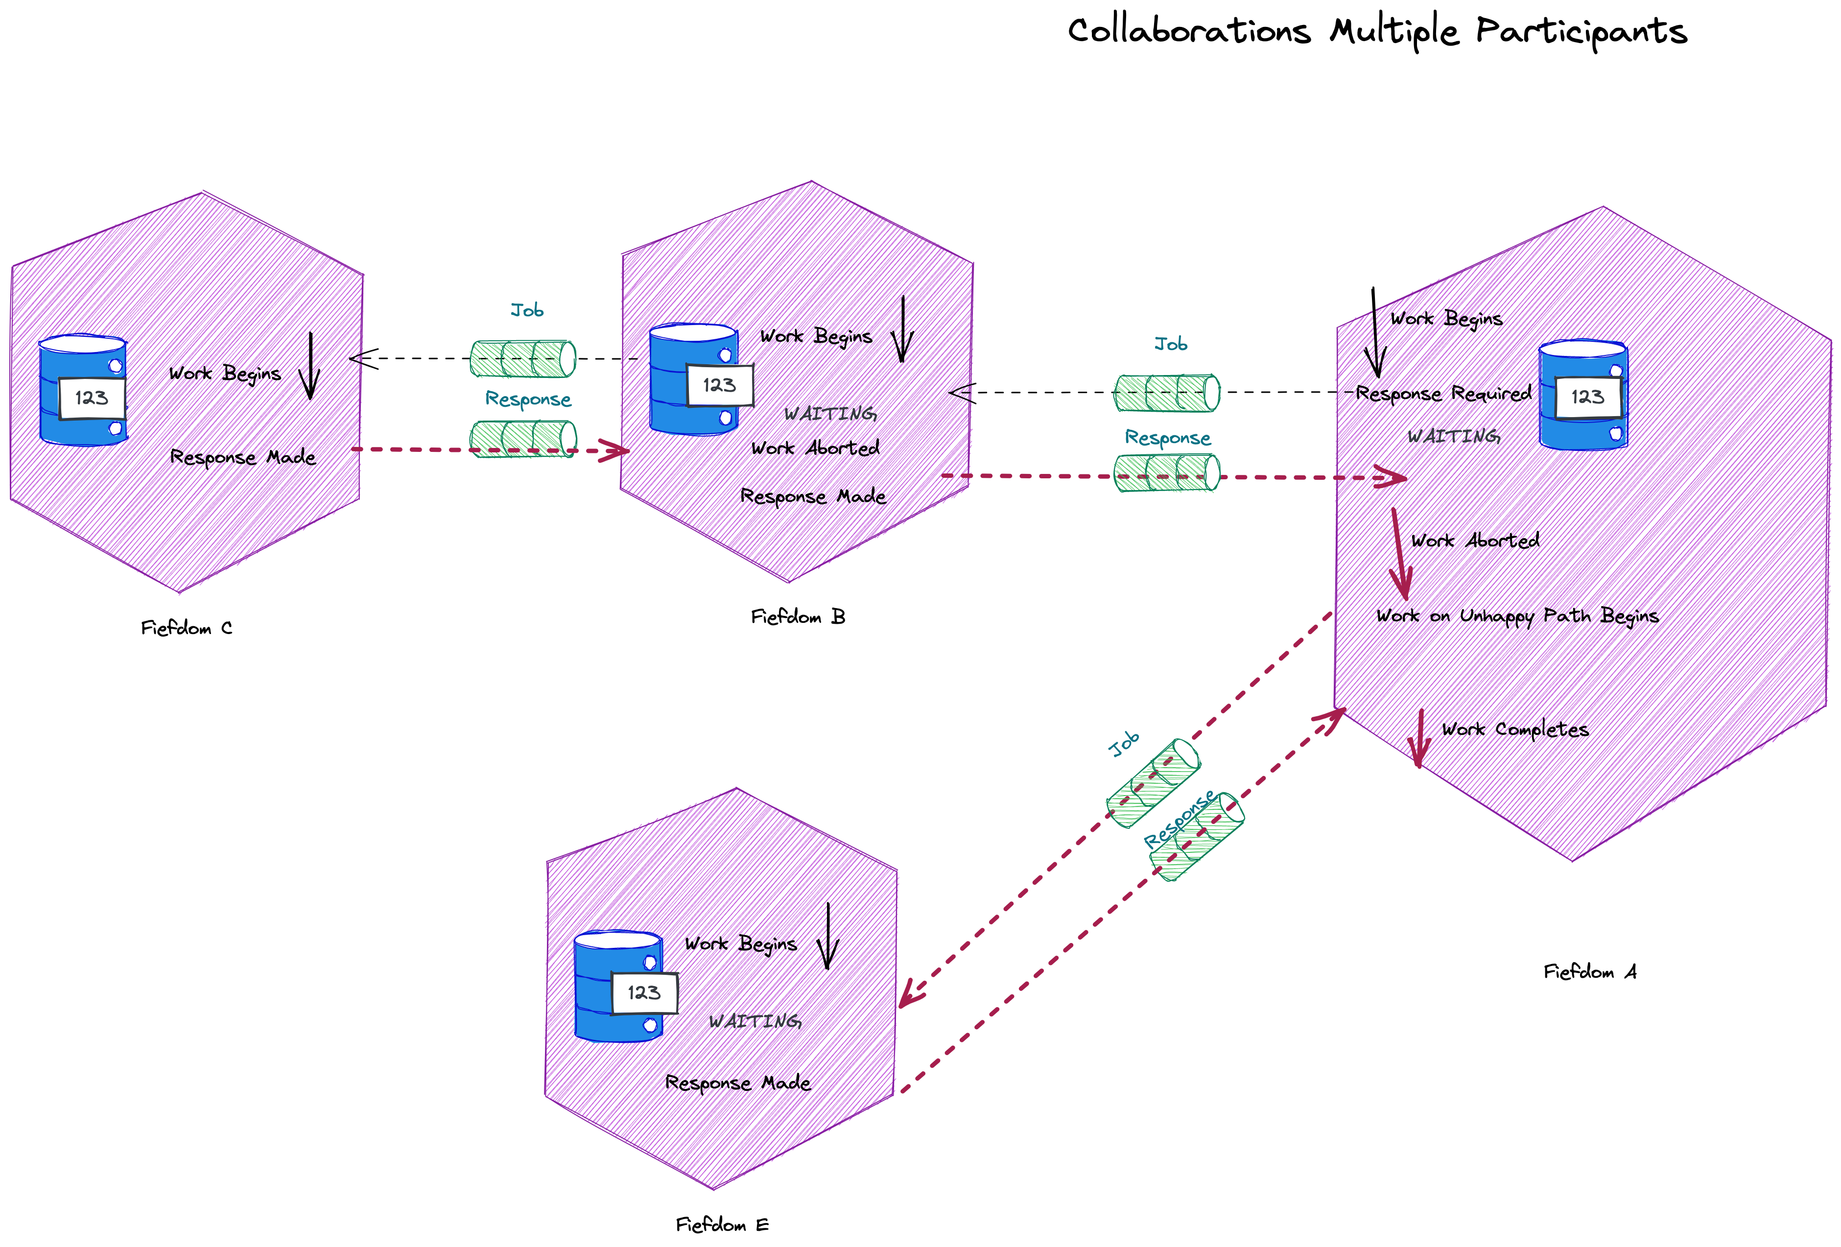
An activity also lets us manage unhappy paths – they are just the states we move into given a unhappy result from an exchange of messages

Slide 16
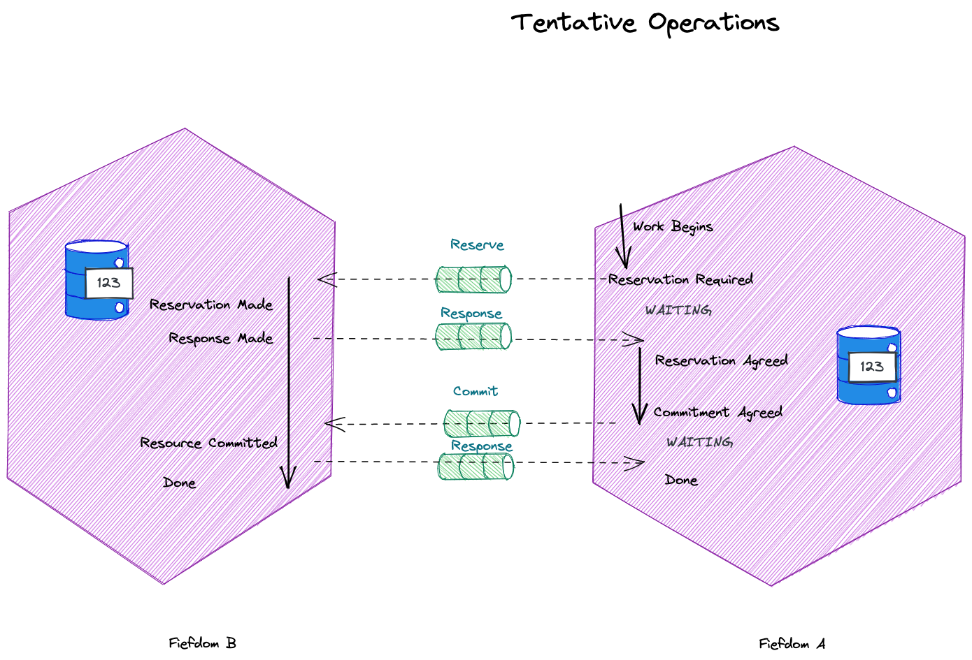
A tentative operation is one where we don’t know if participants should commit yet, we need them to be ready to do so.

Slide 17
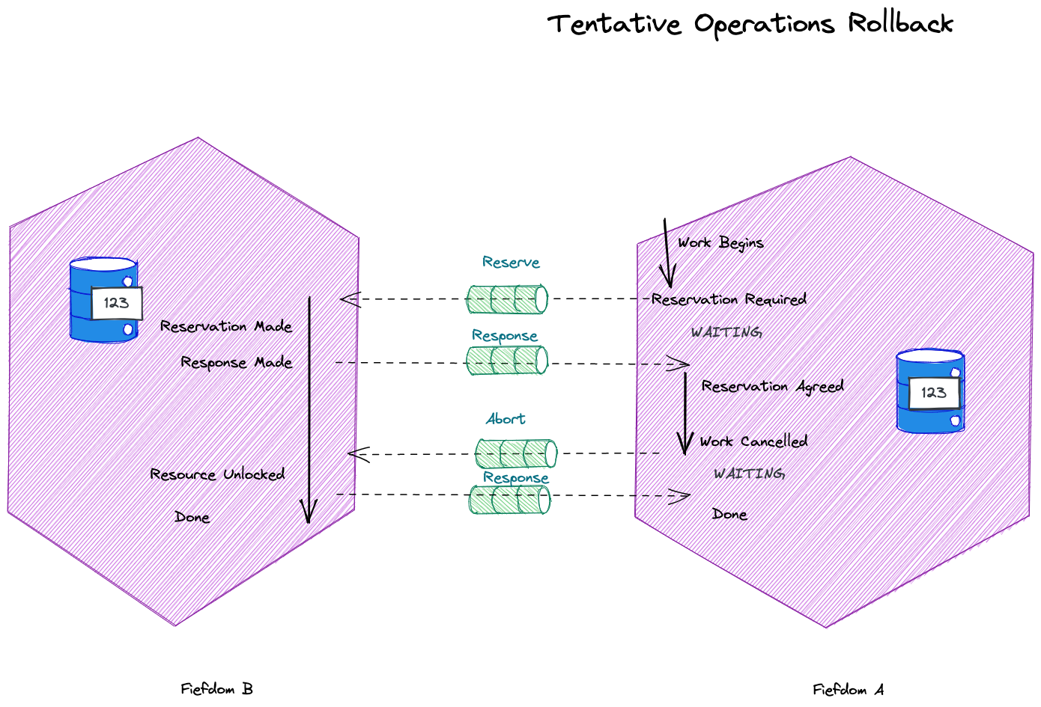
A tentative operation can rollback to unlock resources reserved in another fiefdom.

Slide 18
Of course this looks a lot like 2PC or a saga – but it’s a collaboration so there is no coordinator or process manager. Smart endpoints, dumb pipes.

Slide 19
Pipeline Observability

Slide 20
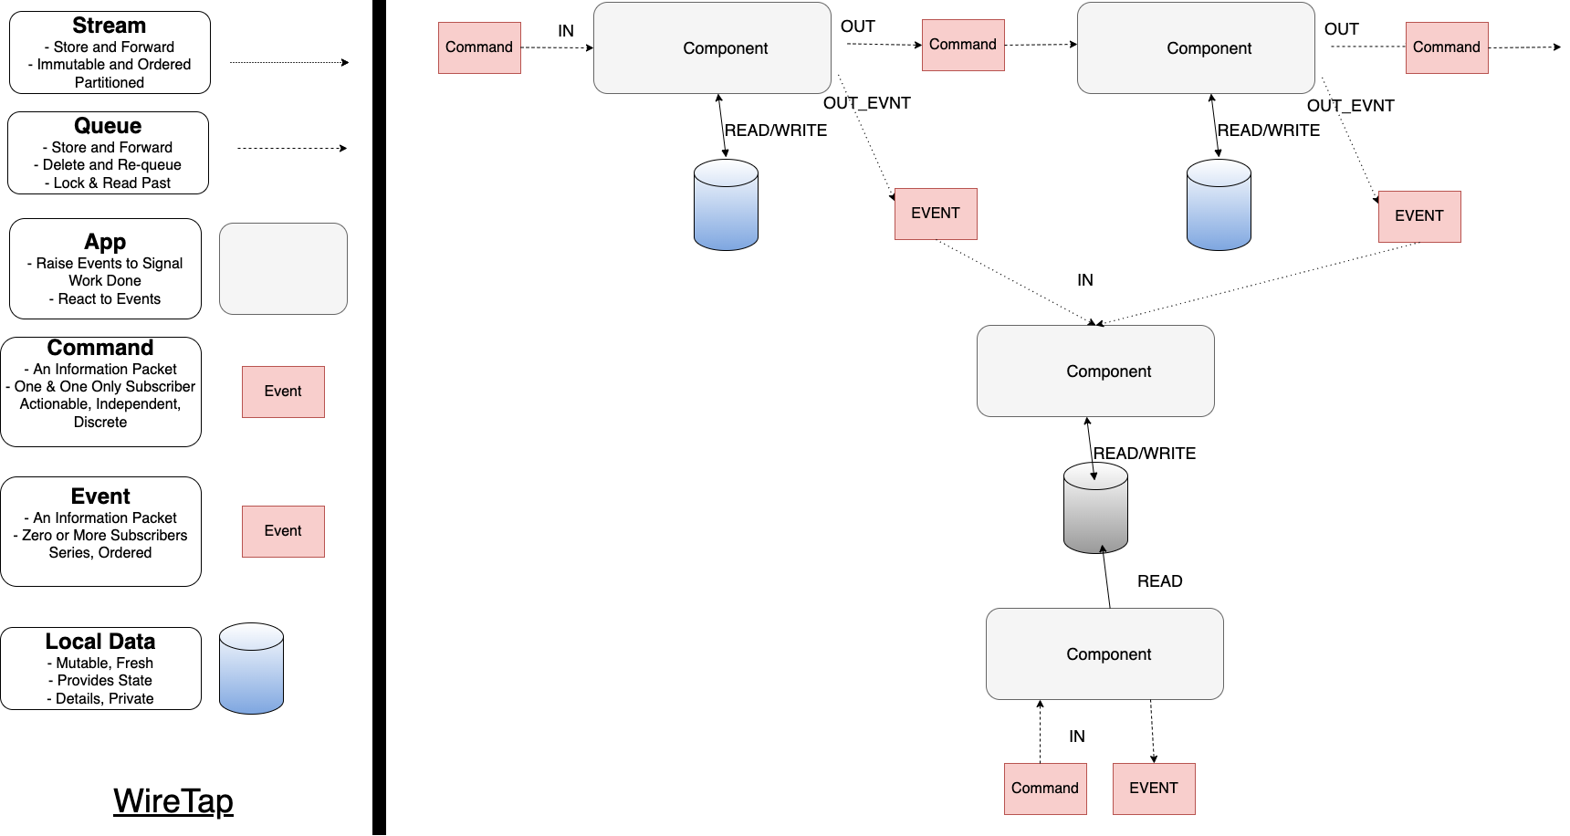
Events represent a notification of a state transition in our workflow
If current state lives in the information packets – messages - flowing through our system, how do we understand the state of a workflow?
We can listen to events to build a view/projection that tells us the last state of the workflow
We can the answer questions about state – often by an HTTP API – when we need to know where in the workflow is this?

Slide 21
Activities

Slide 22
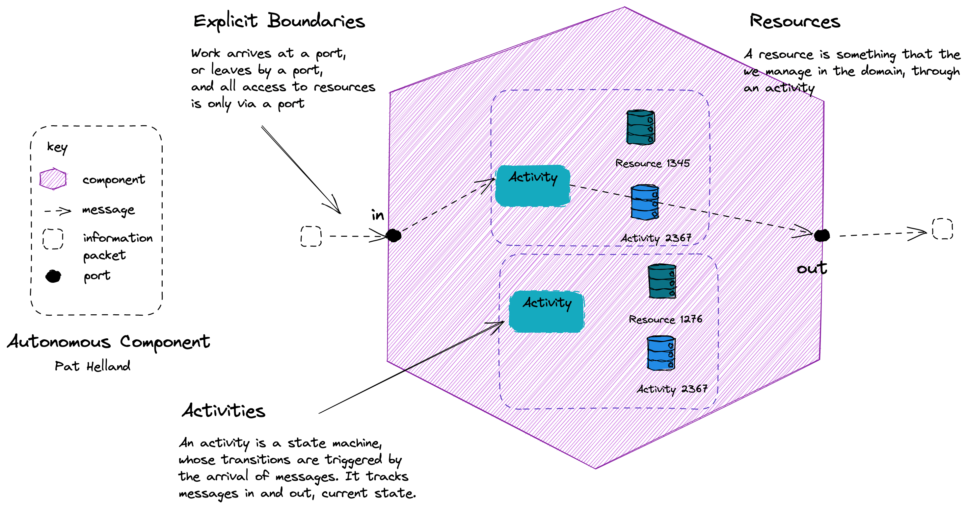
Assert Autonomy A reactive principle where we “by clearly defining the component boundaries, who owns what data and how the owners make it available”
Notes:
Assert Autonomy: Design components that act independently and interact collaboratively. In Reactive applications, autonomy is achieved by clearly defining the component boundaries, who owns what data and how the owners make it available, and by designing them such that each party is afforded the necessary degree of freedom to make its own decisions.
Actors are ONE option: although actor frameworks are one option, reactive applications like this can use many implementation approaches

Slide 23
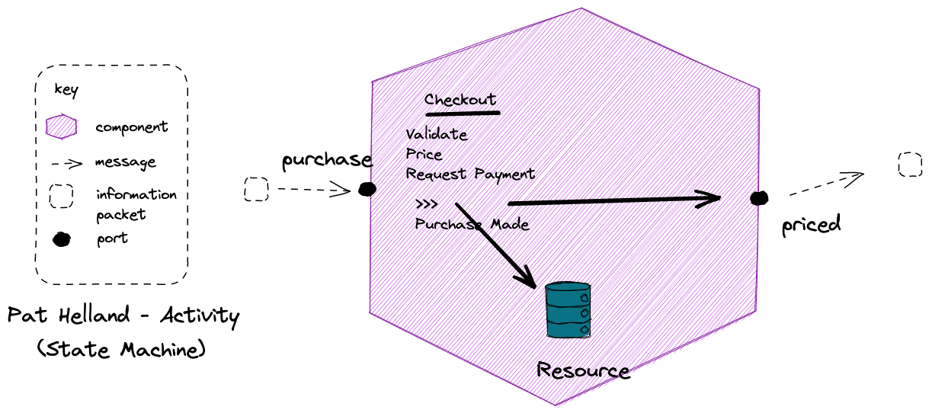
Isolate Mutations A reactive pattern where we “contain and isolate mutable state”. The mutable state lives within a component that has a defined boundary.
Notes:
Resource might be something like vouchers here; once you have used a voucher code for a discount, it can’t be reused by that customer

Slide 24
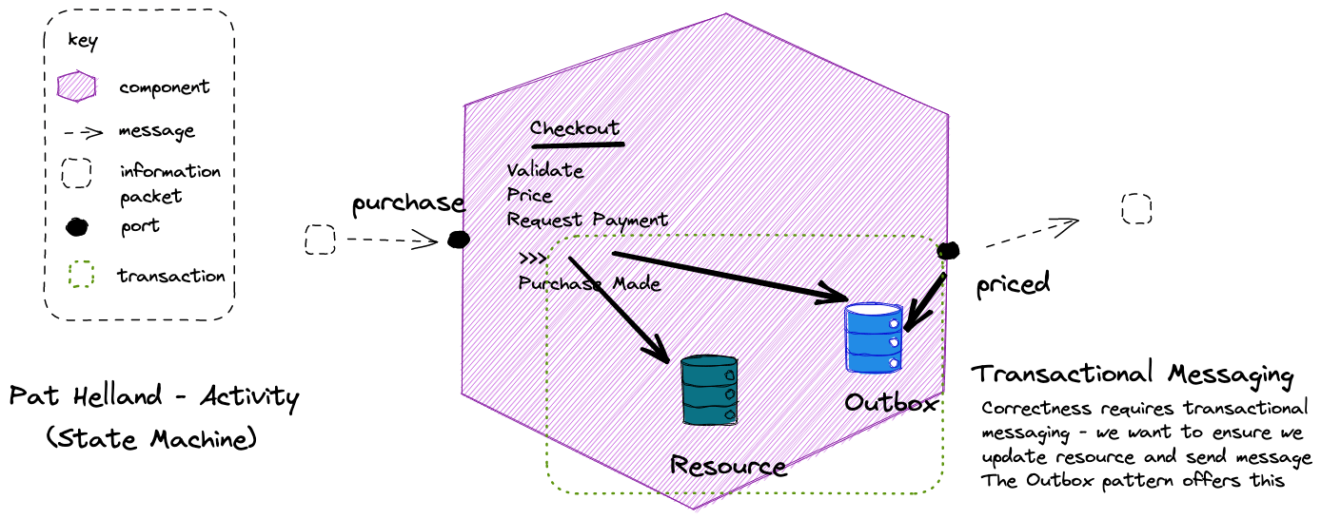

Slide 25
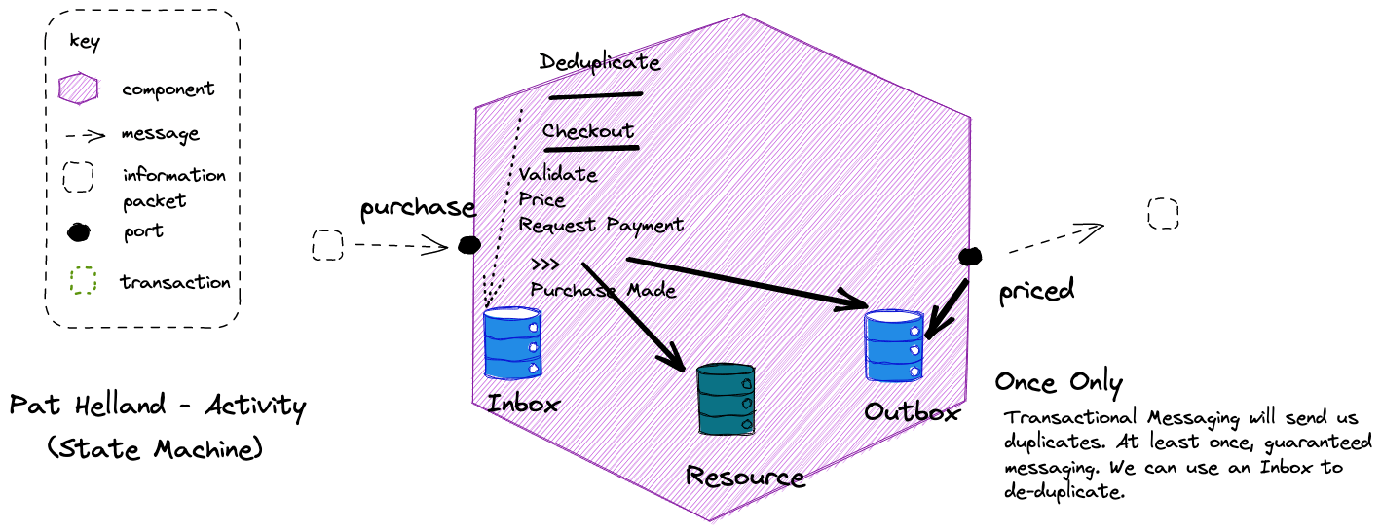

Slide 26
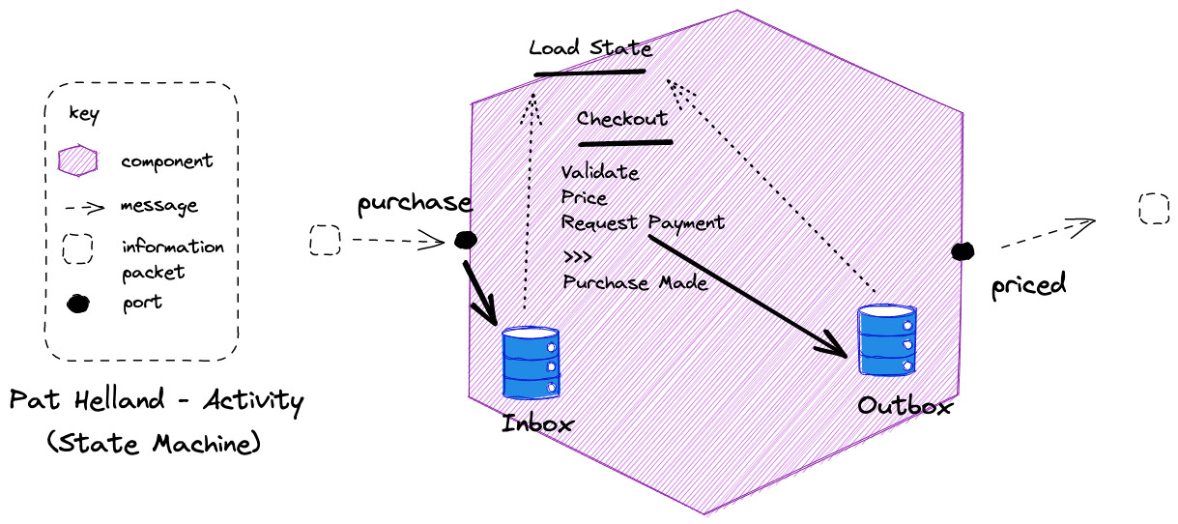
It is possible to calculate activity state by comparing the inbox and outbox to determine where a flow reached, in the event of failure, over storing current state.

Slide 27
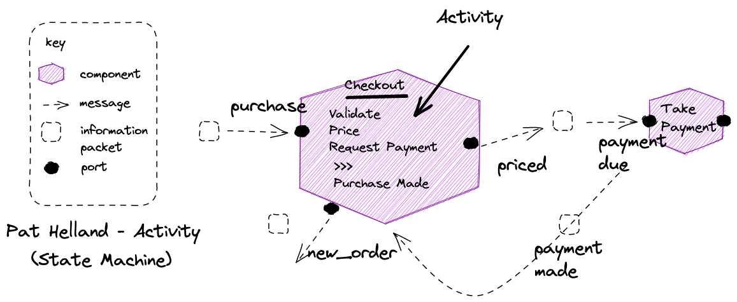
Notes:
No need to block for request-response, we get a reply via a message too

Slide 28
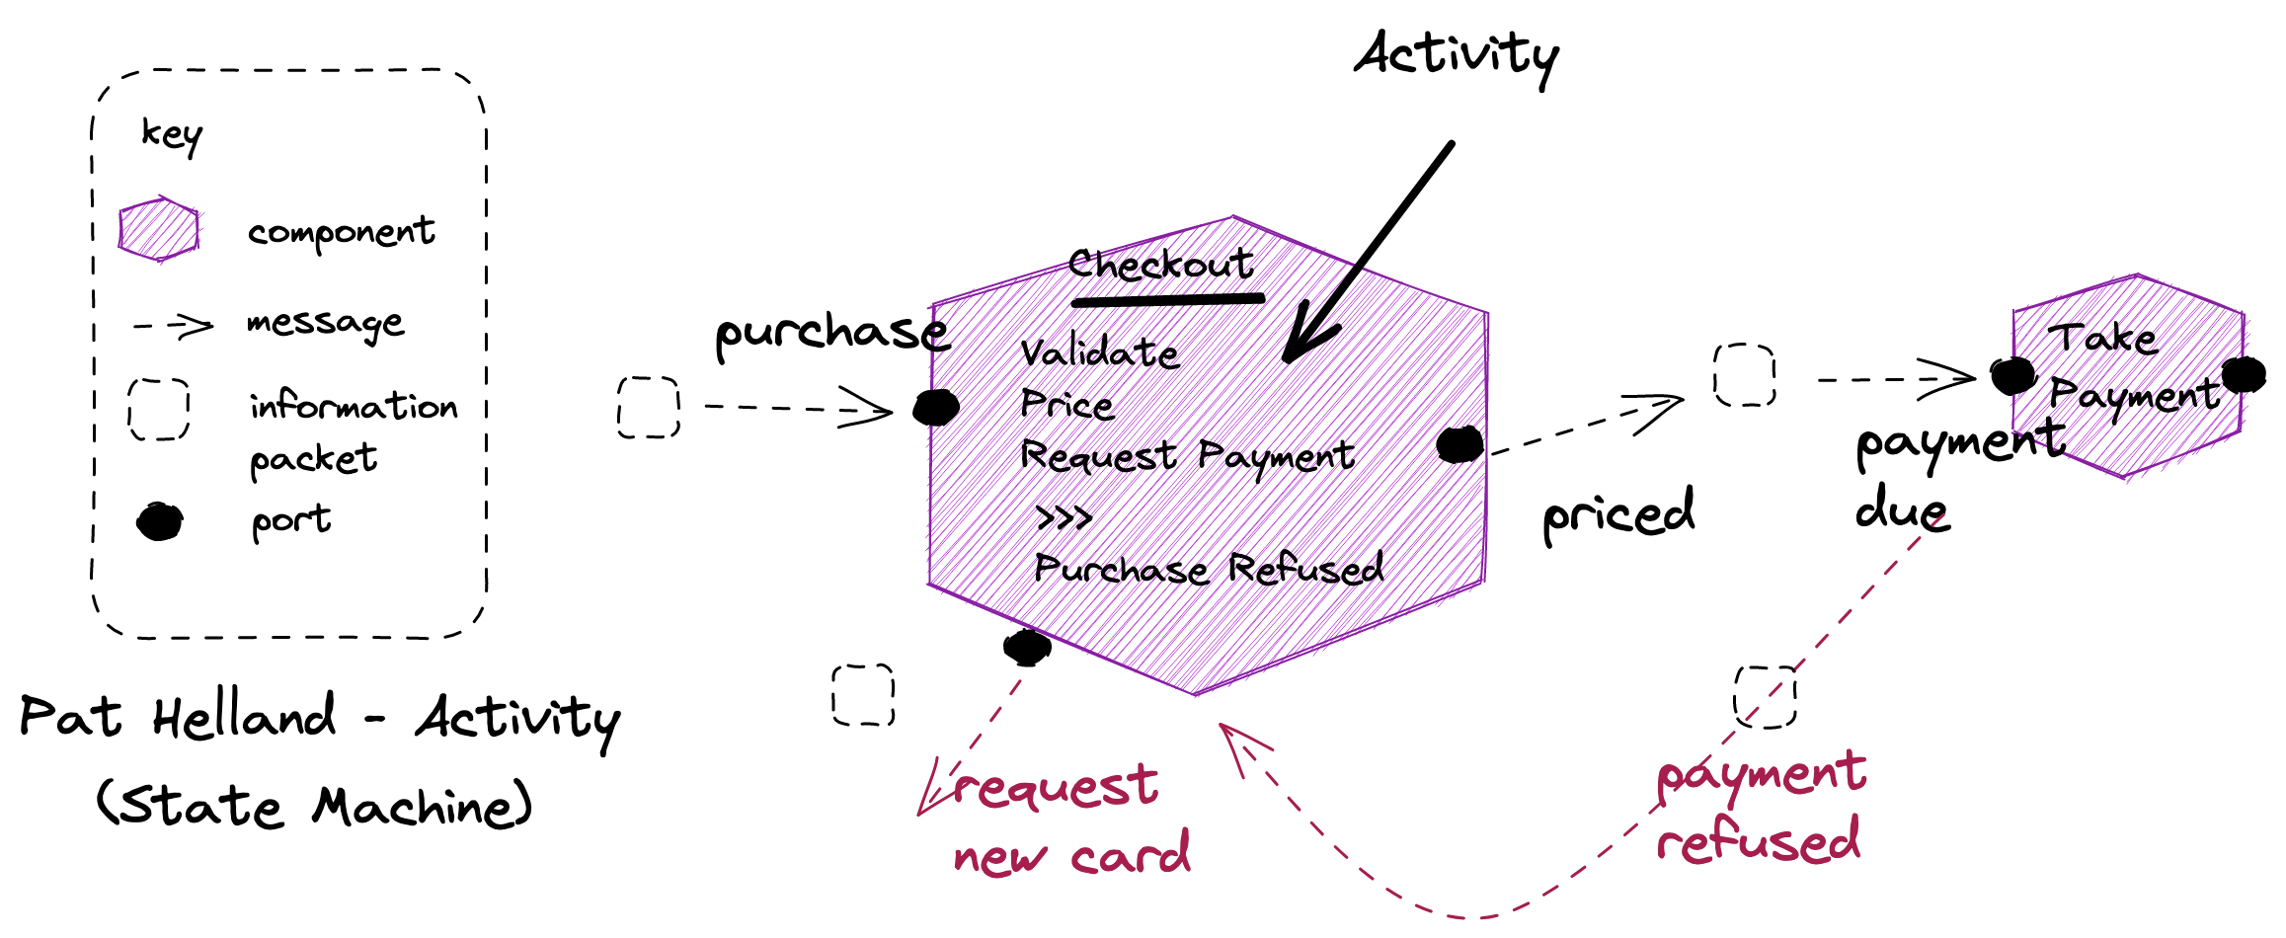
Notes:
Unhappy paths are also messages, just a different message, usually to a different port

Slide 29
Event carried State Transfer (ECST)

Slide 30
Transitive Dependencies
Purchase Order Message
OrderId | Customer First Name | Customer Last Name | Customer Post Code | Restaurant Name | Restaurant Post Code | Order Amount | Order items
12345 | Jo | Doe | SW17 3NJ | Pizza ‘R Us | SW17 5HK | 1038p | …
The lifetime of this data is not the same as the lifetime of the order
This data has a dependency on Customer.
It is a transitive dependency for Order.
If Customer changes, we maybe forced to update an Order message.
This data has a dependency on Restaurant.
It is a transitive dependency for Order.
If Restaurant changes, we maybe forced to update an Order message.
The data items here do not originate in this workflow – Customer Orders – they belong to other workflows – Customer Signup and Restaurant Onboarding.

Slide 31
Normalized
Purchase Order Message
Customer Upserted Message
OrderId | Order Amount | Order items | CustomerId | RestaurantId
12345 | 1038p | …
Customer First Name | Customer Last Name | Customer Post Code
Jo | Doe | SW17 3NJ
What we need to do to use the Purchase Order Message is to “join” it with the Customer and Restaurant data.
Restaurant Onboarded Message
We normalize the message contents.
We have an Id for data from other workflows/services
Restaurant Name | Restaurant Post Code
Pizza ‘R Us | SW17 5HK
The Customer workflow gives us Customer messages
Just like a database we can sometimes inline – denormalize – for performance, but this should be an exception, not the rule
This Restaurant workflow gives us Restaurant messages

Slide 32
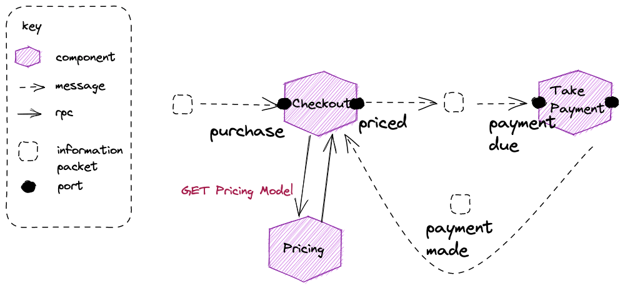
Lookups: We may not have all the data in our component needed to process a message we receive - here we need the prices for your purchase – which implies a lookup such as an HTTP GET to the owner

Slide 33
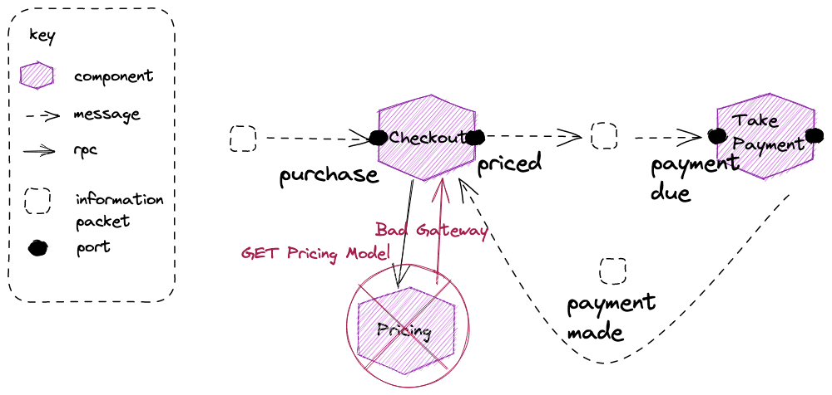
Don’t Do Gets: Don’t use a GET to retrieve data from another service in a reactive architecture. A reactive application uses message passing.

Slide 34
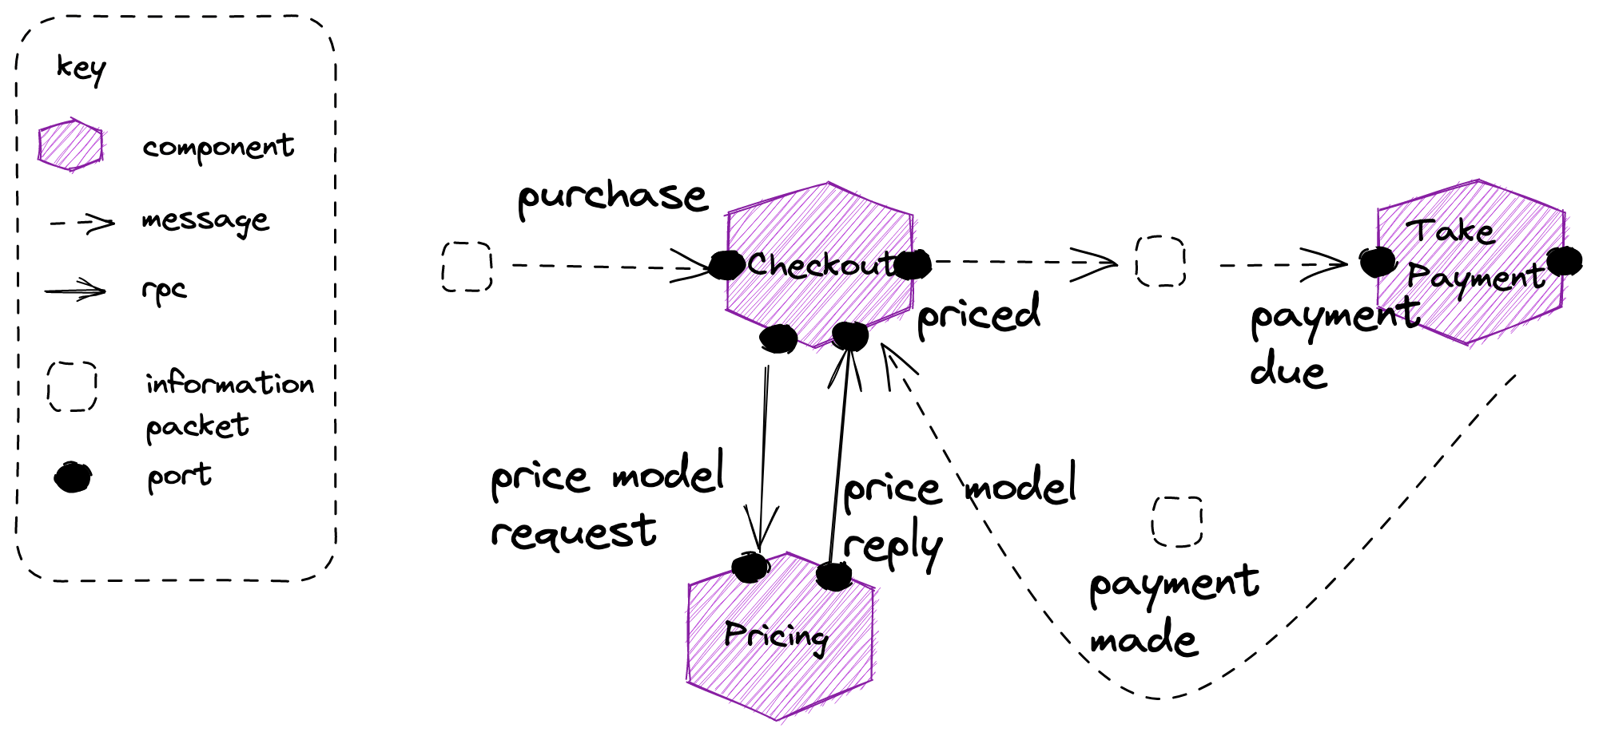
A reactive application uses message passing. Requests here will queue if the pricing module is not available, so will eventually be serviced.
Notes:
We can send a message to request the pricing model, and get a reply, over an asynchronous channel.
This means we need to suspend pricing whilst we wait for a response with the model to come back, and then load the current pricing activity via correlation id

Slide 35
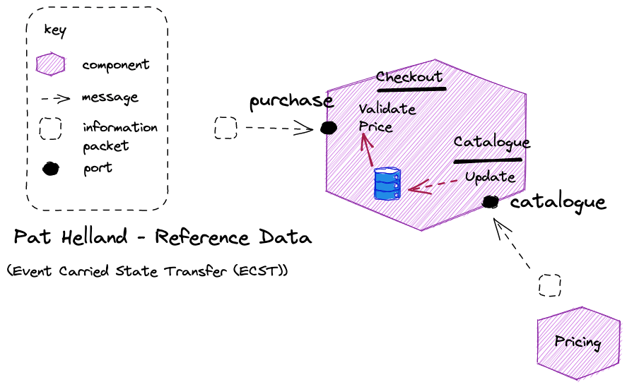
A reactive application uses message passing. What if we want to reduce the latency of the lookup?
ECST: Subscribes to events from a component to builds a forward cache ( projection) of that components published data, and uses it for lookups
Notes:
If we remember FBP lookups, we can simplify and avoid the need to suspend the pricing operation, by having the required information ahead of time

Slide 36
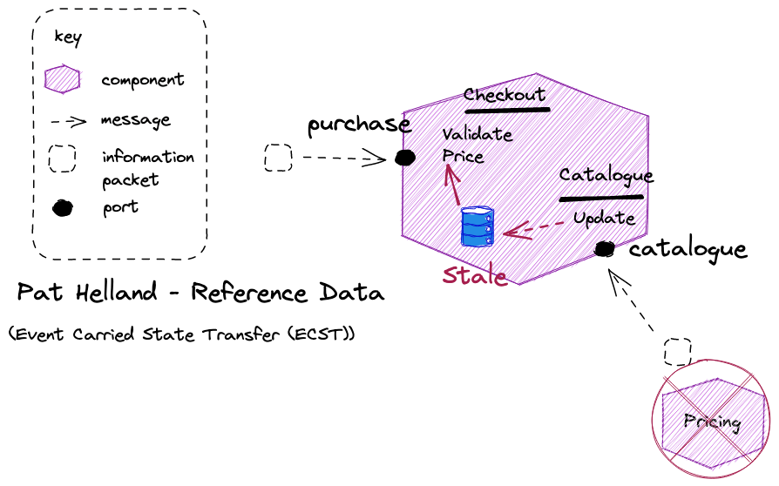
Tailor Consistency: Reactive advises choosing the consistency you need for its trade-offs. Usually we can tolerate eventual consistency – nearly everything is to an extent its just degrees of latency – to gain availability
Eventual Consistency: We are eventual consistent, stale, but continue to be able to lookup. Accepting eventual consistency is a reactive principle.

Slide 37
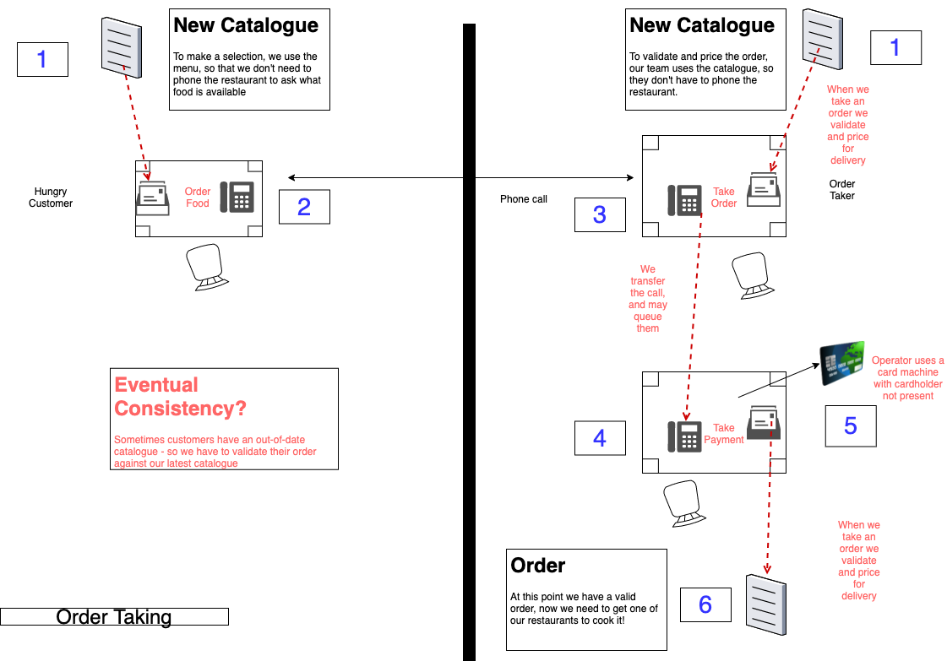

Slide 38
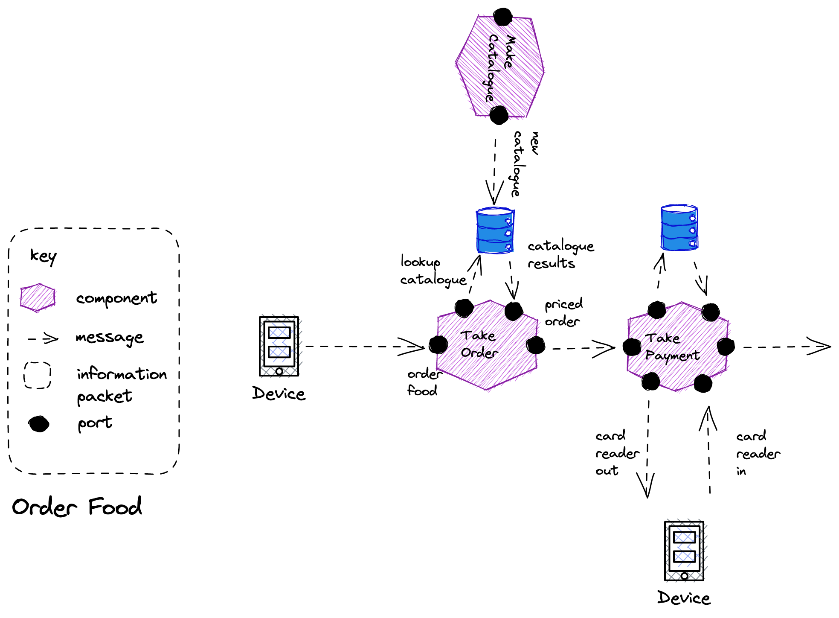
Lookup: We can build a store from IP raised from another component to act as a lookup table for information that we need to process a request.

